Slide 1


Analysis of Social Buzz’s
Top 5 Most
Popular Categories

Slide 2


Today's agenda
Project recap
Problem
The Analytics team
Process
Insights
Summary

Slide 3

Social Buzz is a rapidly growing technology with a huge amount of data produced every day.
Accenture runs a 3-month initial program to make Social Buzz collaborate with Accenture by focusing on these tasks:
An audit of Social Buzz’s big data practice.
Recommendations for a successful IPO.
An analysis to identify the top 5 categories.
Project Recap

Slide 4

Problem
Over 10000 posts per day
Highly Unstructured data
How to draw insights when there is so much?
Analyzing the top-performing categories to provide the most relevant content, maximizing user engagement.

Slide 5



Andrew Fleming
(Chief Technology Architect)
The Analytics team
Marcus Rompton (Senior Principle)
Myself
(Data Analyst)

Slide 6
Process
1
Data Collection
2
Data Cleaning
3
Data Merging
4
Data Analysis
5
Insights Drawn

Slide 7

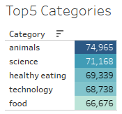

Insights
The entire dataset has 16 unique categories.
The sorted order of the top 5 categories is shown.
DISTINCT CATEGORIES

Slide 8
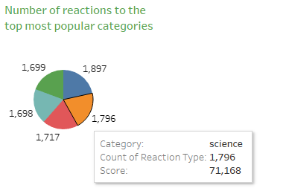
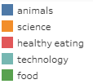
The pie chart provides the data on the number of reactions for each topmost category.
Among the top 5 categories, animals got the highest number of reactions.

Slide 9
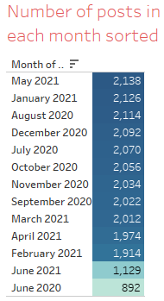
May month in 2021 year has got the highest number of posts.

Slide 10

Gathered all three datasets ( Reactions(R), Content(C), Reaction Type(RT) ).
Removed missing values and unnecessary columns.
Merged all the cleaned datasets into a base dataset ‘R’ using the VLOOKUP formula.
Identified the unique categories and calculated the overall sentiment score for each using the SUMIF formula.
Sorted the score to get the top-performing content categories.
Summary

Slide 11
Thank you!
ANY QUESTIONS?

